Slide 1
Using OSLC to Gain Insight into your Connected Engineering Data — Andy Lapping Technical Enablement Specialist

Slide 2




Andy Lapping
Technical Enablement Specialist and Subject Matter Expert for Engineering Lifecycle Management
20+ years of experience in Systems and Software Modeling
Pre-sales, Training, Consultancy
Content Developer for OCSMP (OMG Certified Systems Modeling Professional) Certification
Author of the Engineering Insights Masterclass
Developer of the Harmony Systems Engineering Toolkit

Slide 3

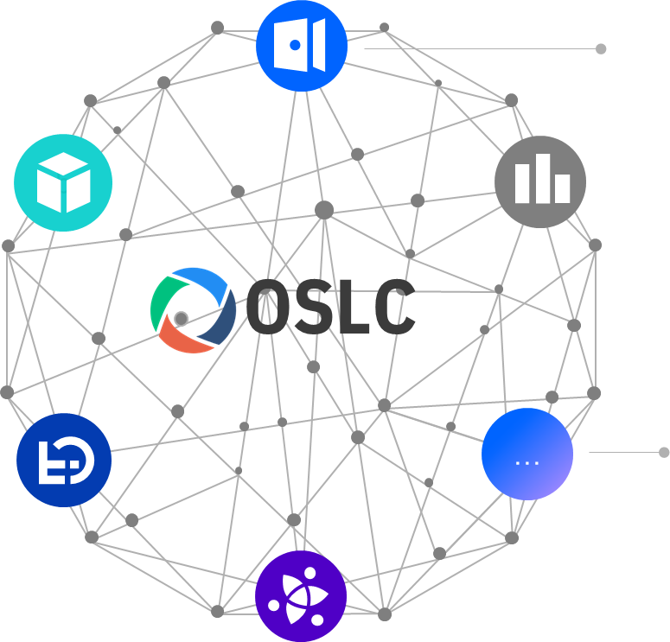
The foundation: OSLC and the IBM Engineering Lifecycle Management platform
Integrated requirements management, architecture management, test management, workflow management and global configuration management
Trace requirements through the lifecycle
b
Leverage integrated
Reporting and analysis capabilities
OSLC
Open Services for Lifecycle Collaboration
Open standard
Based on web technology
Standard link types to connect artefacts
Integrate seamlessly with any application that supports OSLC
…
Integrate seamlessly across the supply chain
Think of it as a corporate network for all your engineering knowledge

Slide 4
Lifecycle Query Index (LQE)
Lifecycle Query Index (LQE)
TRS (Tracked Resource Set)
b
b
OSLC
OSLC
…
…
https://www.oasis-open.org/committees/download.php/61710/Tracked%20Resource%20Set%202.0.pdf

Slide 5
Engineering Insights (ENI)
Lifecycle Query Index (LQE)
TRS (Tracked Resource Set)
b
b
OSLC
OSLC
…
…
https://www.oasis-open.org/committees/download.php/61710/Tracked%20Resource%20Set%202.0.pdf

Slide 6
Demo

Slide 7
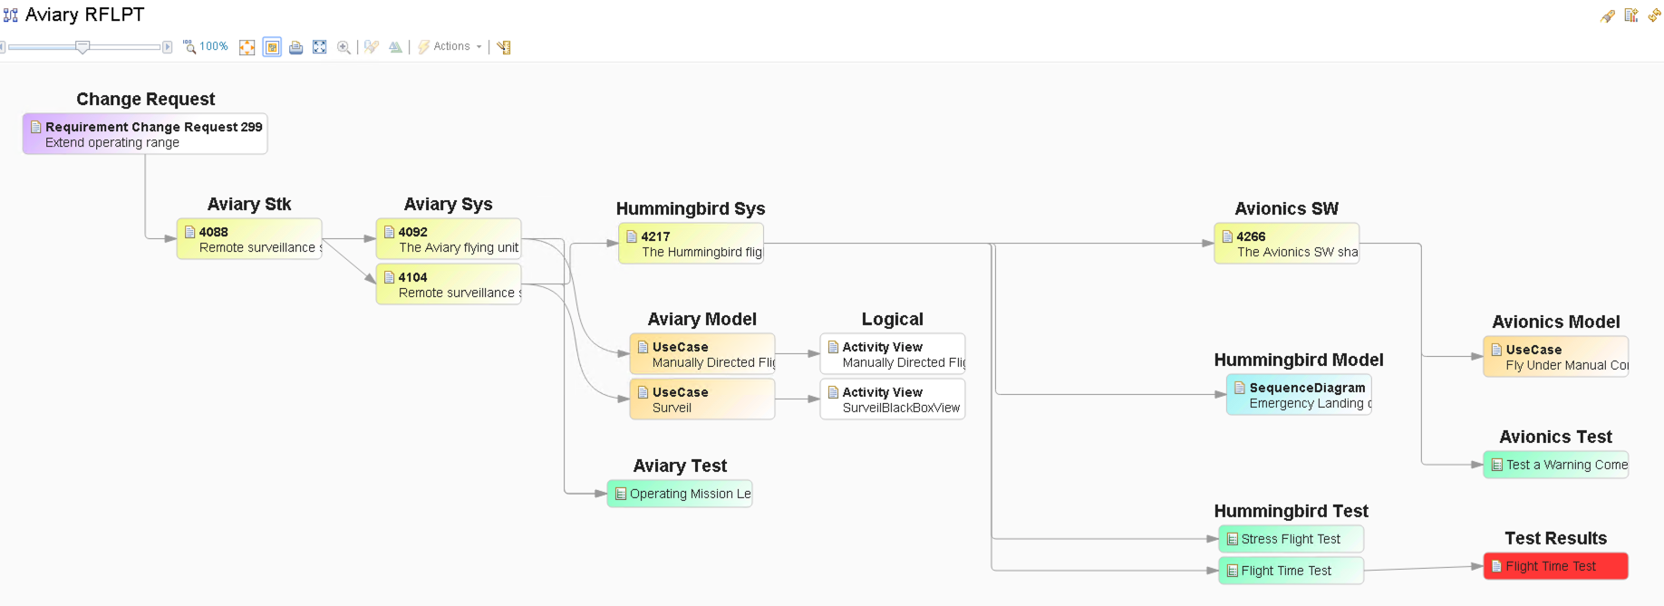
Sample view 1 – Impact Analysis

Slide 8
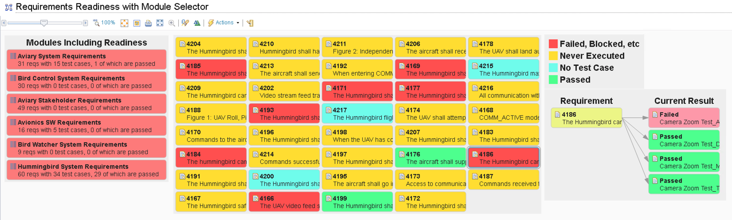
Sample view 2 – Requirements Readiness Explorer

Slide 9
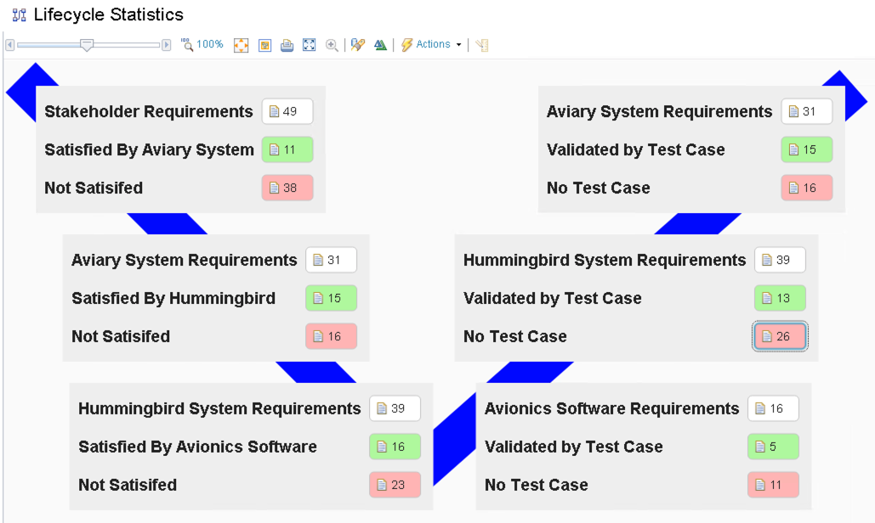
Sample view 3 – Lifecycle Statistics

Slide 10
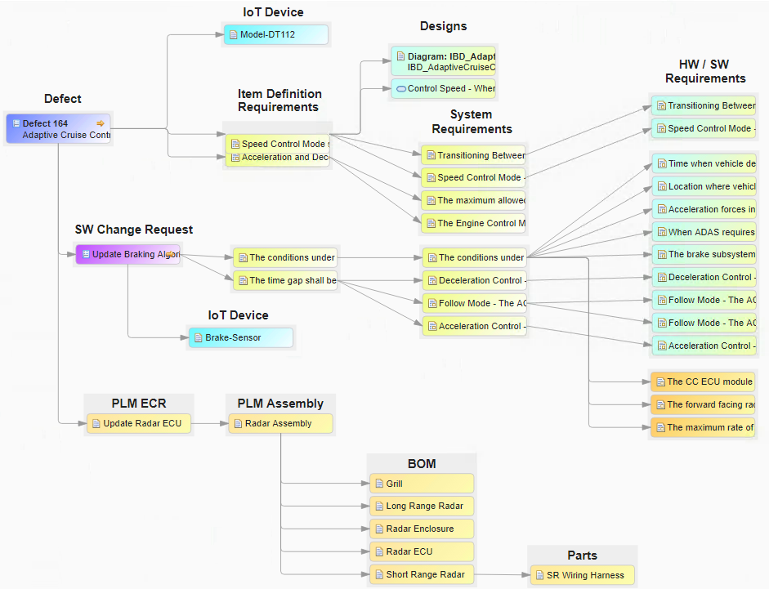
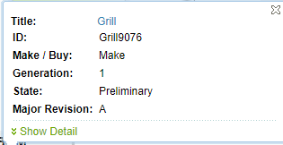
Sample view 4 – PLM
ECR
Rich Hover
BOM Data

Slide 11
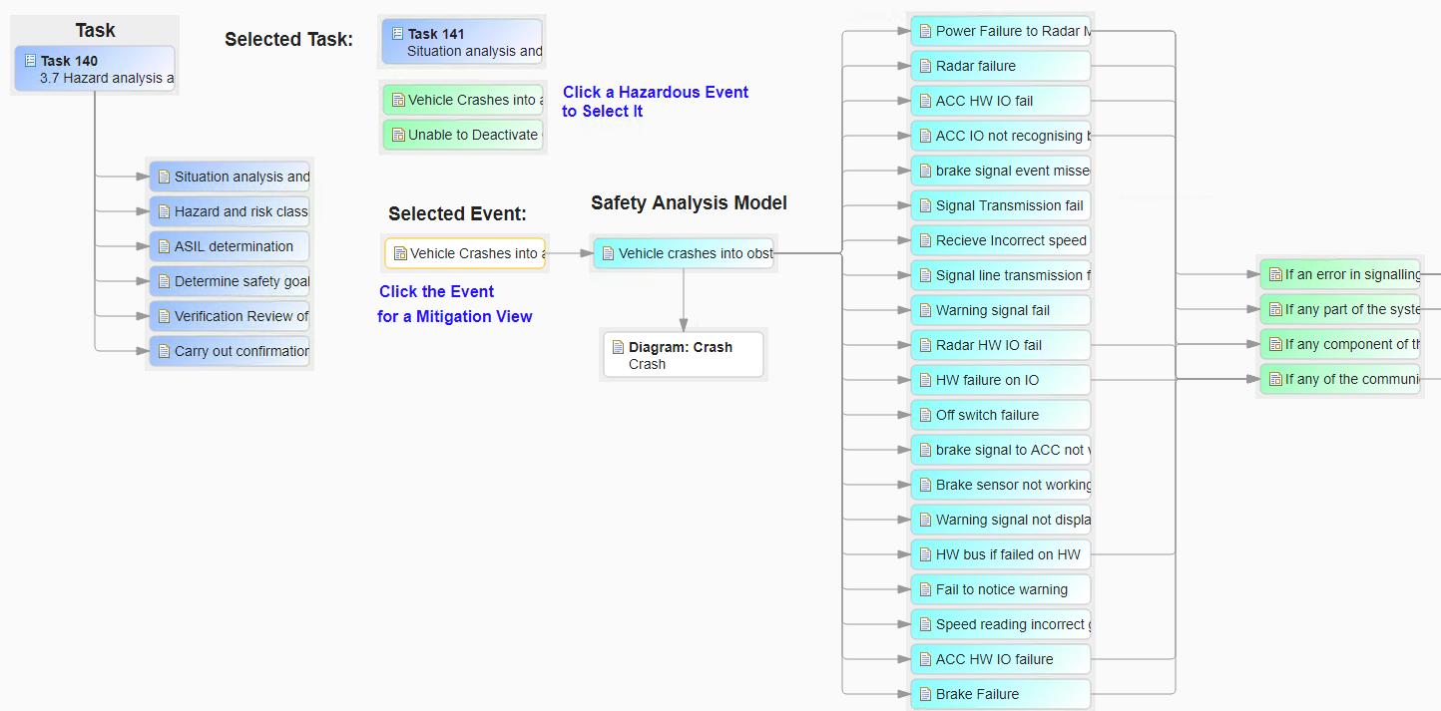
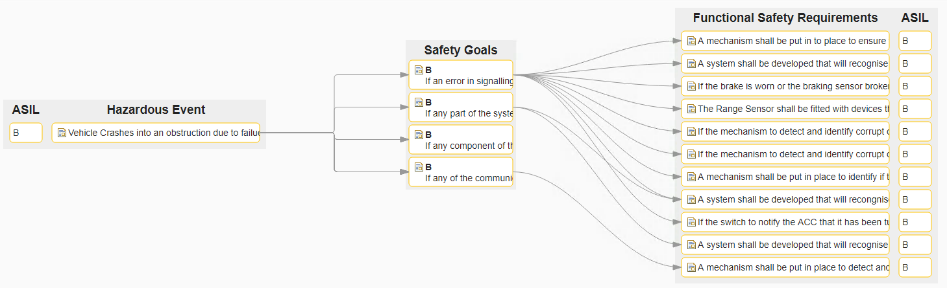
Sample view 5 – ISO 20202 Hazard Analysis

